Slide 1




Rent My Car
TEAM
MERC
Notes:
Buying an expensive car and only using it 1 hour per day is a waste! We had an Idea that can revolutionize the renting business.
So this is our Company. Our Idea lead to two business models that I will present to you. We called them Rent My Car and Trust Rent.

Slide 2
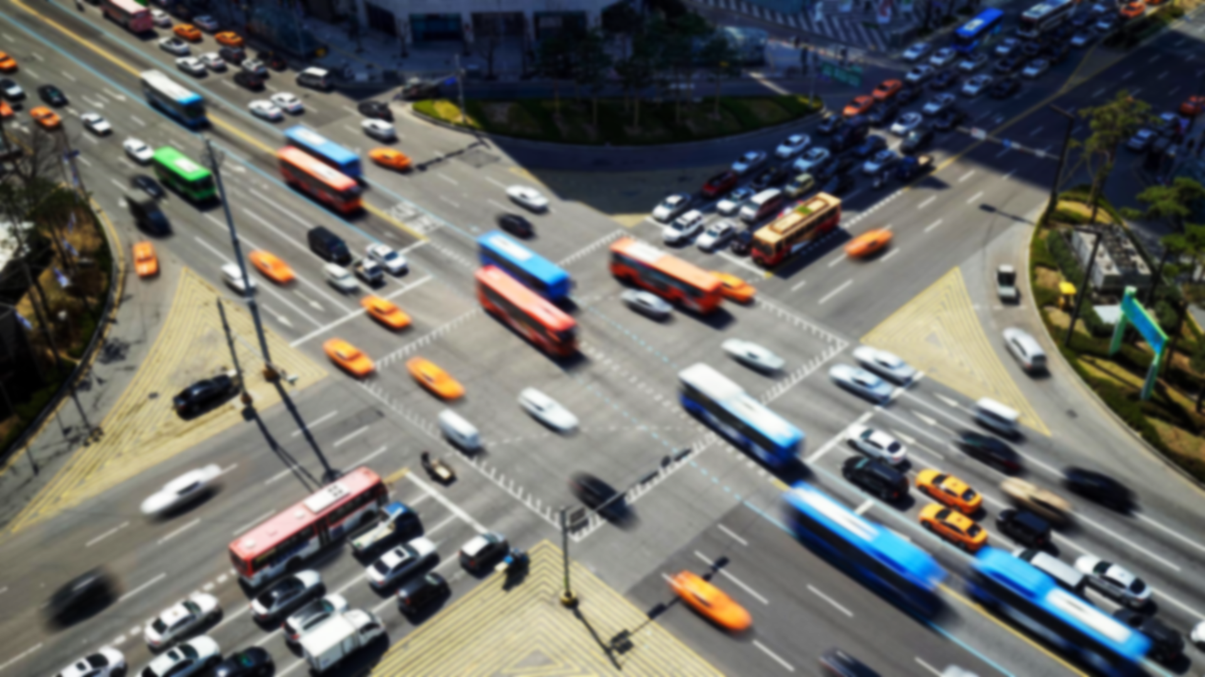
Problems
No trust in renters
Car only used 1h per day
Notes:
The second pr

Slide 3

1. Website/App 2. Driving score algorithm -> Increase trust into the driver
Solution
Notes:
We created a website but this could be easely transfered to an app

Slide 4



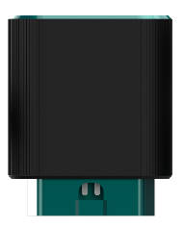
We increase your trust with AI
Scoring Algorithm
Azure Cloud Database
or
OBD-II
Connected Car
Control anytime, any platform

Slide 5
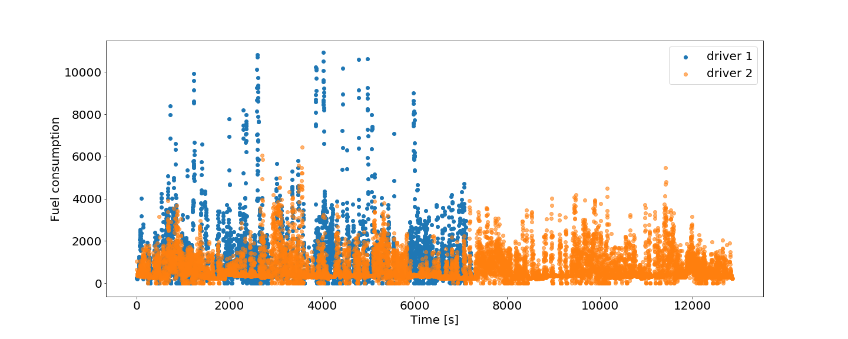
Fuel consumption of two drivers

Slide 6
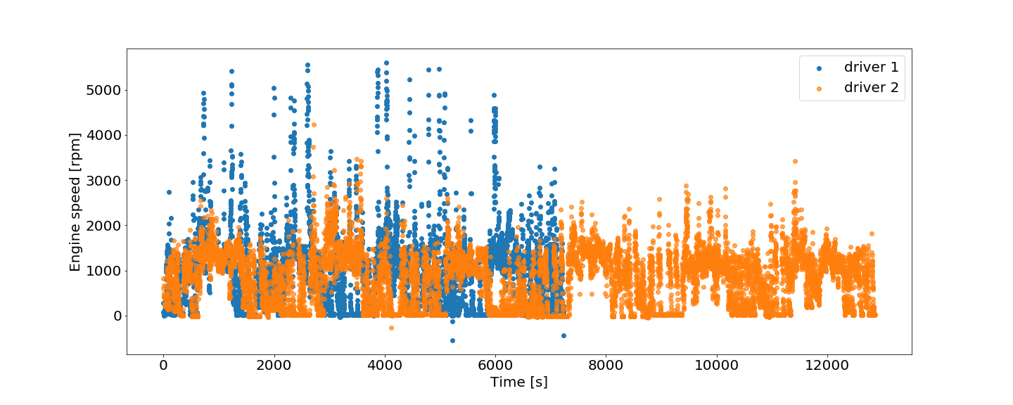
Engine speed of two drivers

Slide 7
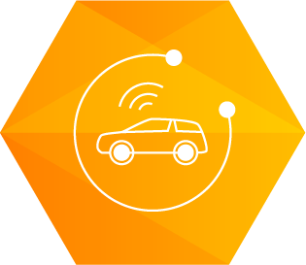
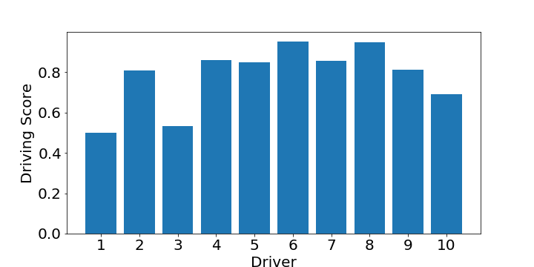
OBD Data -> Driving Score
1. RPM: (Q3)
2. Stering wheel speed: (Q3)
3. Stering wheel angle: (std)
4. Vehicle speed: (threshold)
5. Acceleration speed (Q3)
6. Throttle position: (Q3)
7. Fuel consumption: (Q3)

Slide 8

Score of the renter
8.2
Driving Score
(OBD + Algorithm)
Your feedback to the person who rented the vehicle. (Car treatment score)
Result page for drivers
Driving Recordin Time | Drivering Score (from obd) | Car treatment score (given by car owner) | Final Score (Average)
08.10.2018 | 8.4 | 9 | 8.7
12.10.2018 | 7.9 | 8 | 8.0
19.10.2018 | 8.3 | 8 | 8.2
05.11.2018 | 5.2 | 7 | 6.1
26.11.2018 | 8.8 | 3 | 5,9
Notes:
DRIVER ALSO SCORES THE VEHICLE.
END: ONLY FOR EUROPE AND US. BLABLA CAR HAS SHOWN THAT THIS CONCEPT WILL NOT WORK IN TURKEY BECAUSE OF TRUST ISSUES.

Slide 9
Trust Rent
Notes:
SECOND BUSINESS IDEA IS TRUST RENT FOR THE TURKISH MARKET

Slide 10




Problems with commercial vehicles
High Cost coming from
Ensurence company can’t trust the driver
One Month minimum rent time*
*https://jda.com/-/media/jda/knowledge-center/thought-leadership/2017stateoflogisticsreport_new.ashx
Notes:
TRANSPORTATION VEHICLE

Slide 11

Keep smart, keep it safe
Trust by Driving
Analysis
Flexible
Renting Times
More
Costumers
More realistic ensurence prices by including driving scores

Slide 12


Competitor and Competition Advantages
Features/Product | Trust Rent | Sahibinden.com | Garajyeri.com | Ryder | FILO Companies
Driving behaviour analysis
B2B and B2C Segment
short-term rental
Connected Car Platform
Spesific Car Segment

Slide 13

Verified, targeted market!
+
+
$6,5B
$4.5B
Europa rant a car market value
USA rent a car market value
https://www.statista.com/outlook/270/109/car-rentals/united-states?currency=usd

Slide 14
Thank You Guys
Notes:
SECOND BUSINESS IDEA IS TRUST RENT FOR THE TURKISH MARKET

